Slide 1
Subject Name :Database Management System Presentation Title: Cloud Database
JEPPIAAR INSTITUTE OF TECHNOLOGY
“Self-Belief | Self Discipline | Self Respect”
Department of Computer Science and Engineering
Team Members:
Students Name Reg. No:
1.Suren Raj. P 210618104050
2.Kalaiarasan. A 210618104022
3.ArunKumar. S 210618104008
4.Ravi Bharathi. R 210618104038
5.Bhuvaneshwaran. R 210618104008
6.Harish. R 210618104019

Slide 2
Objective
Cloud Database
Cloud database means a database that is accessible to clients from the cloud and delivered to users on demand via the Internet from a provider's servers. Also referred to as Database-as-a-Service (DBaaS), cloud databases can use cloud computing to achieve optimized scaling, high availability, multi-tenancy and effective resource allocation.
Traditional Databases in the Cloud
While a cloud database can be a traditional database such as a MySQL or SQL Server database that has been adopted for cloud use, a native cloud database such as Xeround's MySQL Cloud database tends to better equipped to optimally use cloud resources and to guarantee scalability as well as availability and stability.

Slide 3
Diagram

Slide 4
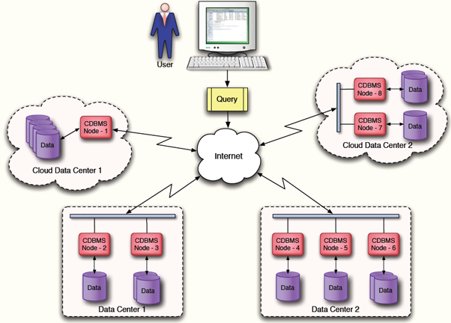
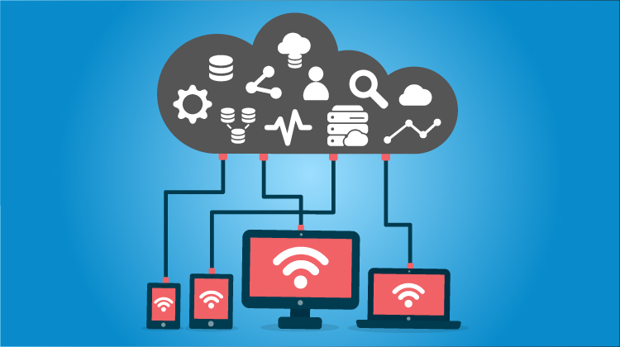
Block Diagram/ Work Flow/ Flow Chart

Slide 5
The Benefits of Having a Cloud-Based Database
Cloud databases offer many of the same benefits as other cloud services, including
Improved agility and innovation. Cloud databases can be set up very quickly and decommissioned just as quickly—making testing, validating, and operationalizing new business ideas easy and fast. If the organization decides not to operationalize a project, it can simply abandon the project (and its database) and move on to the next innovation.
Faster time to market. When using a cloud database, there’s no need to order hardware or spend time waiting for shipments, installation, and network setup when a new product is in the development queue. Database access can be available within minutes.

Slide 6
Technical details
Reduced risks. Cloud databases offer numerous opportunities to reduce risk across the business, particularly for DBaaS models. Cloud services providers can use automation to enforce security best practices and features and to lower the probability of human error—the primary cause of software downtime. Automated high-availability features and service level agreements (SLAs) can reduce or eliminate loss of revenue due to downtime. And capacity forecasting is no longer a critical issue when implementing projects, because the cloud can be an infinite pool of just-in-time infrastructure and services.
Lower costs. Pay-per-use subscription models and dynamic scaling allow end users to provision for steady state, then scale up for peak demand during busy periods, and then scale back down when demand returns to steady state. This is much less costly than maintaining these capabilities in-house, where organizations must purchase physical servers that can handle peak demand even though they may only need peak capabilities a couple of days per quarter. Enterprises can save money by literally turning services off when they’re not needed. They can also reduce costs by executing global initiatives with marginal infrastructure investment. In many instances, cloud software automation takes the place of high-cost database administrators (DBAs)—thereby reducing operational expenses by eliminating the need for expensive in-house resources.

Slide 7
Cloud Database Management Choices
Enterprises have choices in how to manage their cloud databases. Database management styles can be generalized into the following four categories:
Self-managed cloud databases. In this model, an organization runs its database on a cloud infrastructure but manages the database itself, using in-house resources, without any automation being integrated by the cloud vendor. This model offers some of the standard benefits of locating a database in the cloud—including improved flexibility and agility—but the organization maintains responsibility and control over database management.
Automated cloud databases. In this model, organizations use database cloud service application programming interfaces (APIs) to assist with lifecycle operations, but they maintain access to the database servers and control database configuration and operating systems. Automated database services feature limited SLAs and typically exclude planned activities, such as patching and maintenance.

Slide 8
Technical Details
Managed cloud databases. This model is similar to automated cloud databases, but the cloud vendor does not allow consumer access to servers hosting the database. Configuration is limited to cloud vendor–supported configurations, because end users are not allowed to install their own software.
Autonomous cloud databases. This is a new, hands-free operating model in which automation and machine learning eliminate the human labor associated with database management and performance tuning. Services include SLAs for business-critical applications, such as zero-downtime operations for unplanned and planned database and service lifecycle activities.

Slide 9
Technical Details
Top Cloud Database
Amazon Web Services
SAP
Enterprise DB
Garantia Data
Cloud SQL by Google
Azure by Microsoft
Rackspace

Slide 10
Cloud Database Solutions—What Should Run in the Cloud?
Most every industry, from financial services to healthcare, can benefit from using cloud database solutions. The choice is not whether or not to use a cloud database. The choice is which model and type will work best to meet an enterprise’s specific needs.
Many organizations choose to take a staged approach to cloud database utilization, blending traditional cloud database models with DBaaS models. For others, such as those in the financial services industry, keeping mission-critical applications in-house could remain a priority.

Slide 11
Future Scope
The Database of the Future: “Self-Driving” Cloud Databases
The newest and most innovative type of cloud database is the self-driving cloud database. Whereas on-premises databases require a dedicated DBA to manage them, that same deep DBA expertise is not necessary for managing a self-driving cloud database. This database type uses cloud technology and machine learning to automate database tuning, security, backups, updates, and other routine management tasks that have traditionally been performed by DBAs.
Self-driving databases are designed to automatically withstand hardware failures, including those at cloud platform sites, and offer online full-stack patching of software, firmware, virtualization, and clustering. They easily scale performance and capacity as needed. Additionally, they protect data from both external attacks and malicious internal users, and they avoid many of the downtime-related issues of the other models—including planned maintenance.

Slide 12
Conclusion
Cloud computing databases are extremely popular for reducing IT complexities and operational costs. They prevent the hassle of licensing, traditional procurement, maintenance, and installation involving a huge number of IT staff. With the rapid increase in the business pace, cloud databases enable organizations to cut down on the in-house IT resources required to manage huge sets of data.

